Slide 1
Evolution schema
Using databricks and data factory
BY
KAILASH S

Slide 2
agenda
Project Statement
Project Overview
Project Requirements
Architecture Diagram
Implementation
Conclusion

Slide 3
Problem statement
Implement a project where Azure Data Factory handles schema evolution by moving data to the Data Lake, and Azure Databricks adjusts the schema dynamically based on the incoming data.

Slide 4
project overview
This project focuses on utilizing Azure Data Factory (ADF) to handle schema evolution by moving data to the Data Lake, and Azure Databricks dynamically adjusting the schema based on incoming data. The goal is to create a flexible and adaptive data processing pipeline that accommodates changes in the schema seamlessly.

Slide 5
prerequisites
Azure Subscription
Azure Databricks
Azure Data lake
Azure Data factory

Slide 6


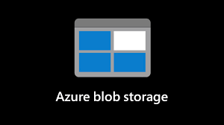

Architectural diagram

Slide 7

Azure databricks
Azure Databricks is optimized for Azure and tightly integrated with Azure Data Lake Storage, Azure Data Factory, Azure Synapse Analytics, Power BI and other Azure services to store all your data on a simple, open Lakehouse and unify all your analytics and AI workloads.

Slide 8
Azure data factory
Azure Data Factory is a cloud-based data integration service provided by Microsoft Azure. It allows you to create, schedule, and manage data pipelines that can move data between supported on-premises and cloud-based data stores. Azure Data Factory facilitates the process of data movement and data transformation to enable data-driven workflows for analytics and reporting.

Slide 9

Azure data lake storage
Azure Data Lake Storage (ADLS) is a cloud-based storage solution provided by Microsoft Azure for big data analytics. It's designed to enable organizations to store and process vast amounts of data in a scalable and cost-effective manner. ADLS is part of the Azure Data Lake, which also includes Azure Data Lake Analytics and Azure HD Insight. ADLS supports different storage tiers, allowing you to optimize costs based on the access patterns of your data.

Slide 10
Schema evolution
"Evolving schema" typically refers to the ability of a data storage system or database to adapt and accommodate changes to the structure of the data over time. In traditional relational databases, the schema is often fixed and rigid, making it challenging to handle changes to the data model without significant disruptions to existing applications.

Slide 11
implementation

Slide 12
Data source
The data is taken from squirrel census website where it takes count of squirrels sighted in a park
https://www.thesquirrelcensus.com/data
Park_data.csv

Slide 13
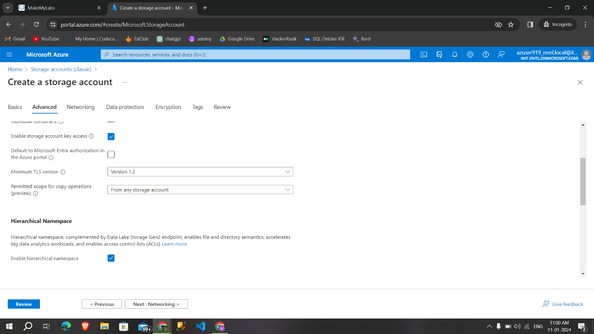
Creating storage account

Slide 14
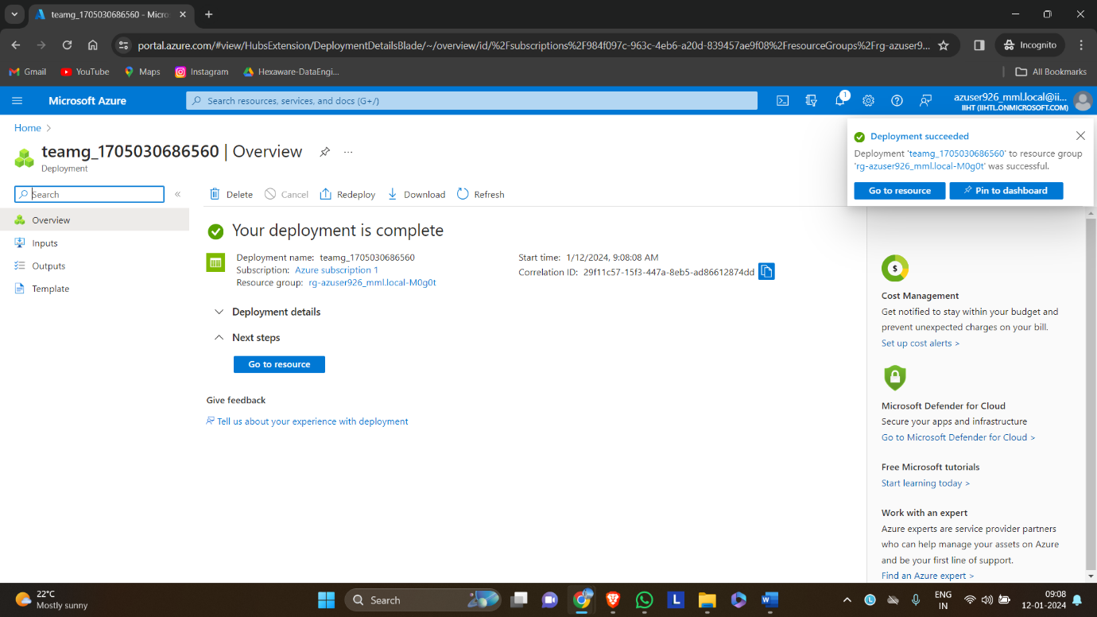
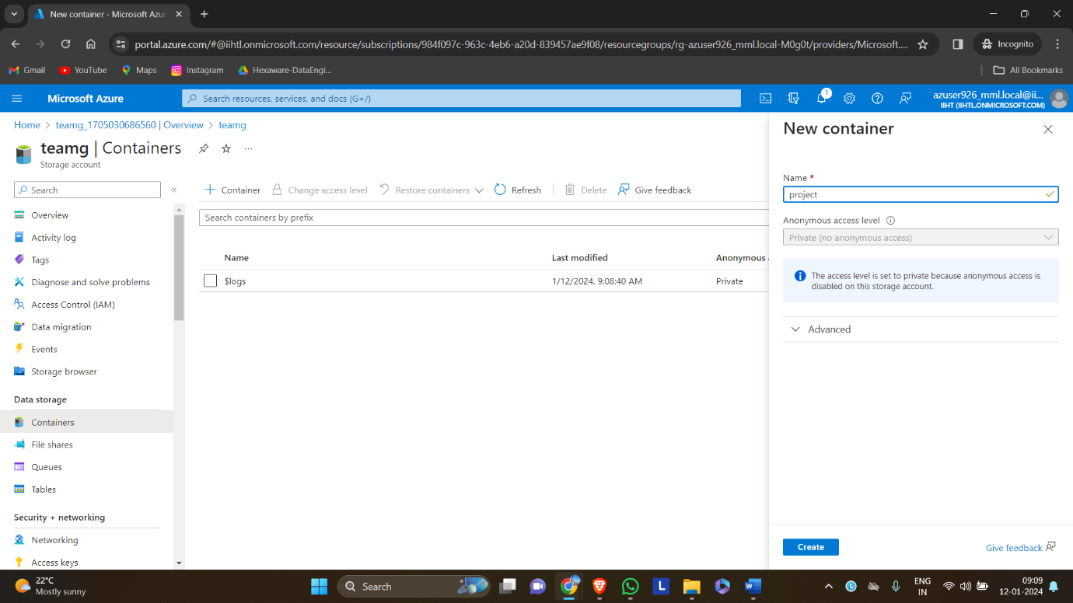
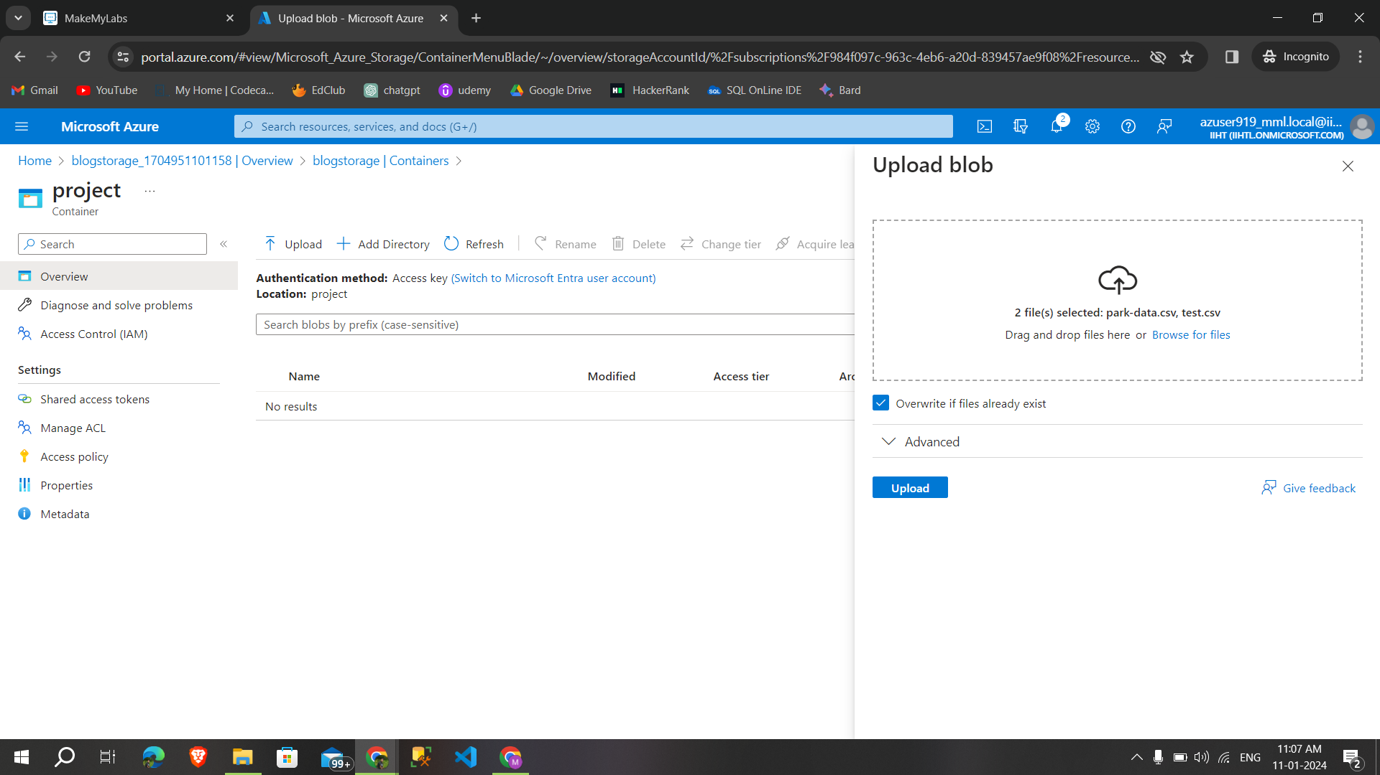
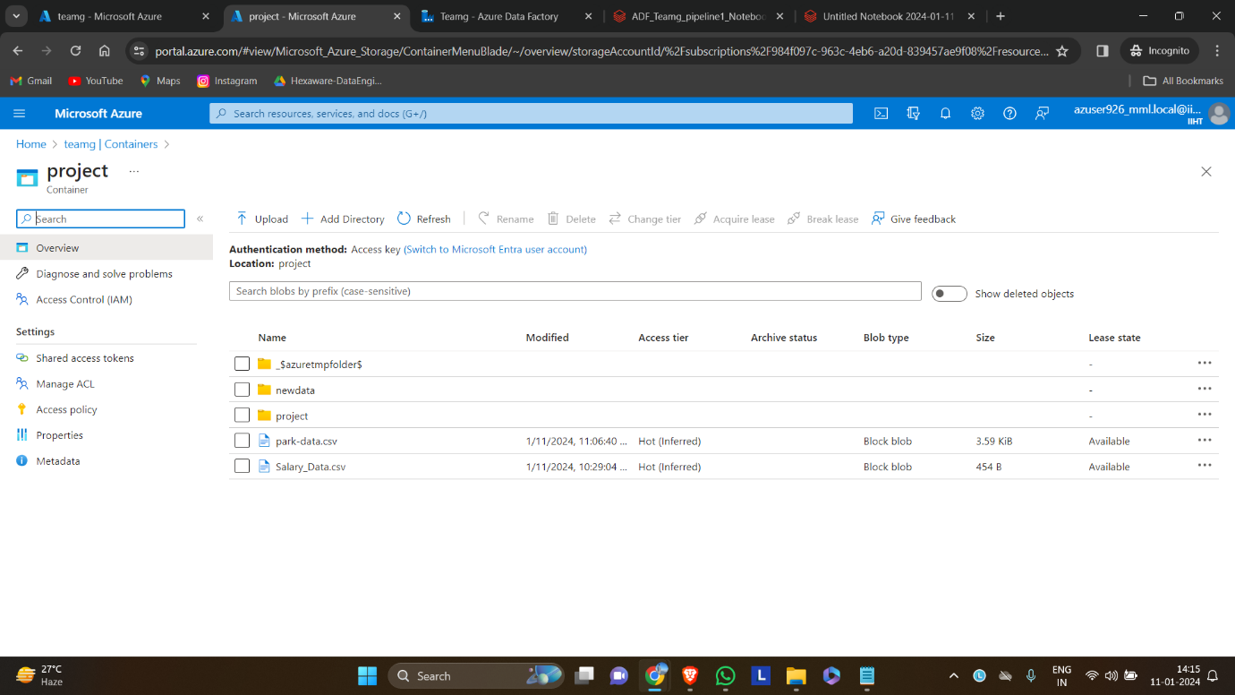

Slide 15
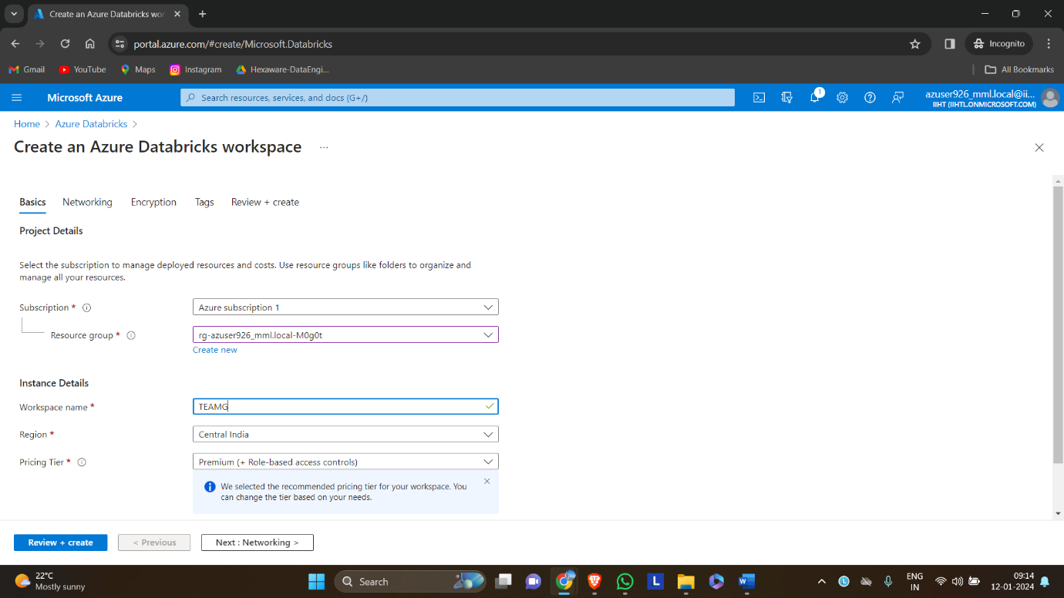
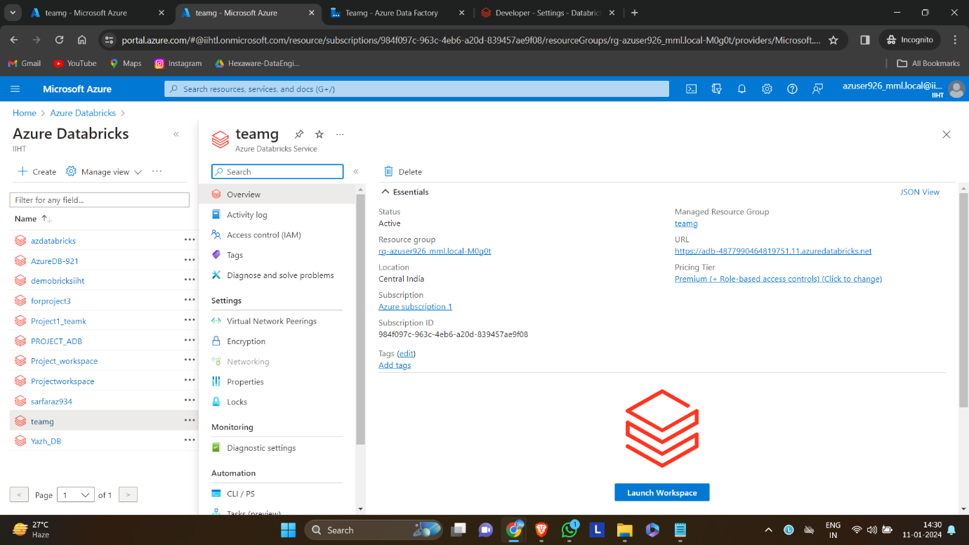
Creating databricks workspace

Slide 16
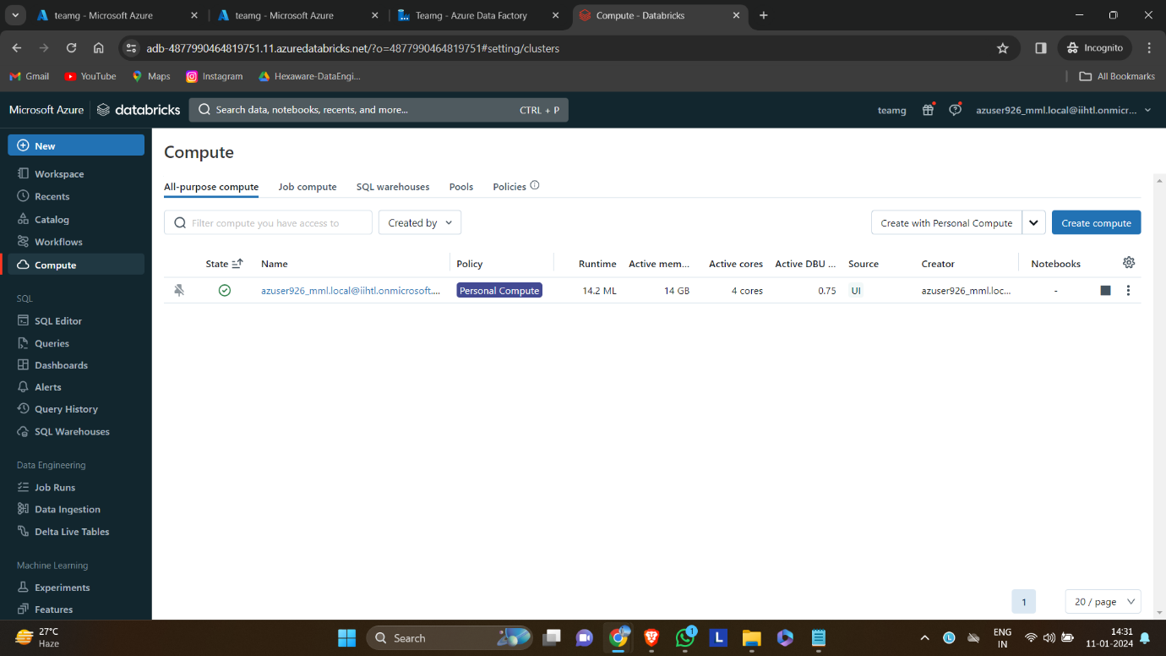
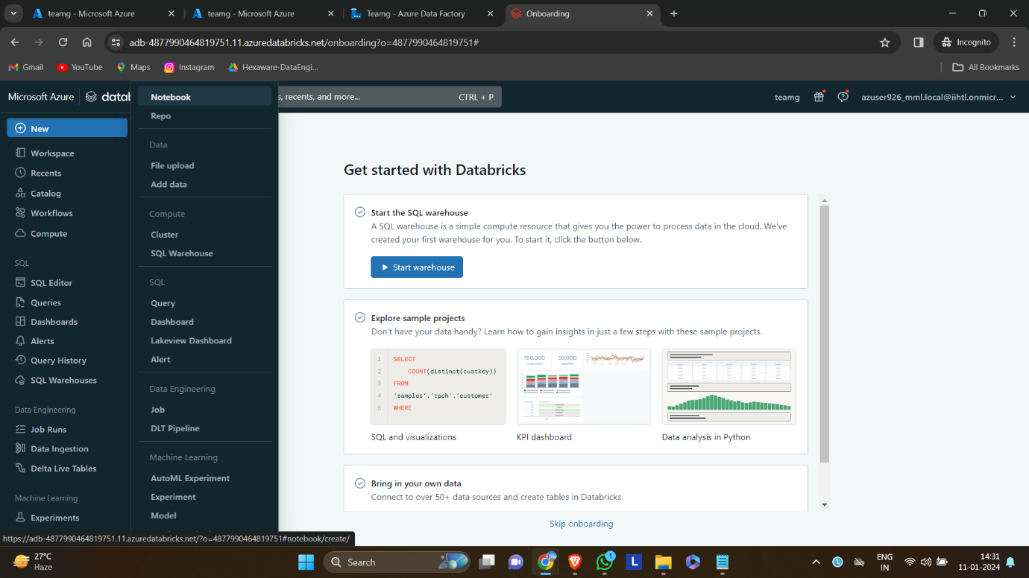
Creating cluster and notebook

Slide 17
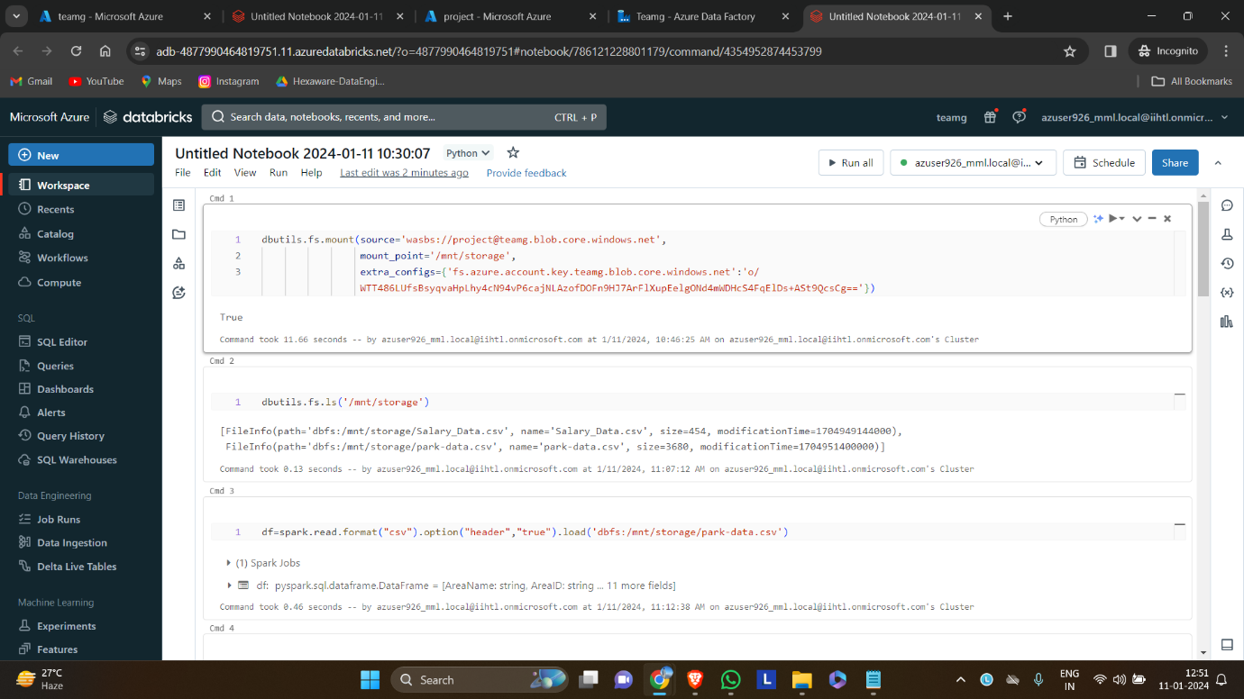
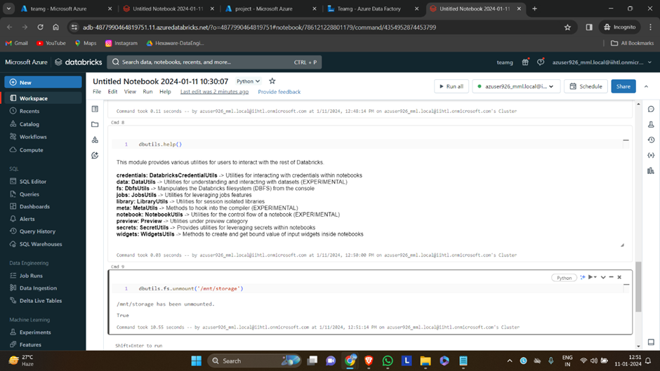
mounting the data or schema

Slide 18
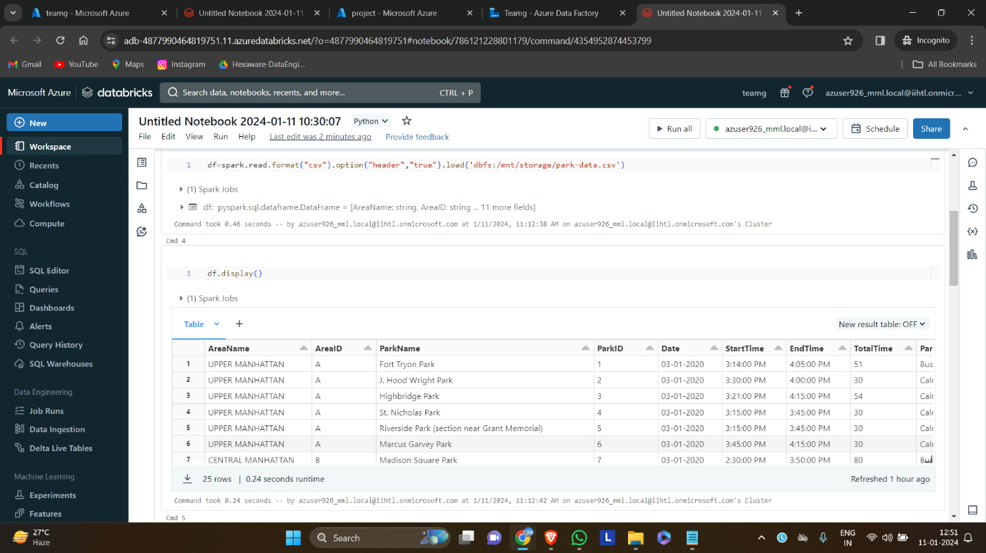
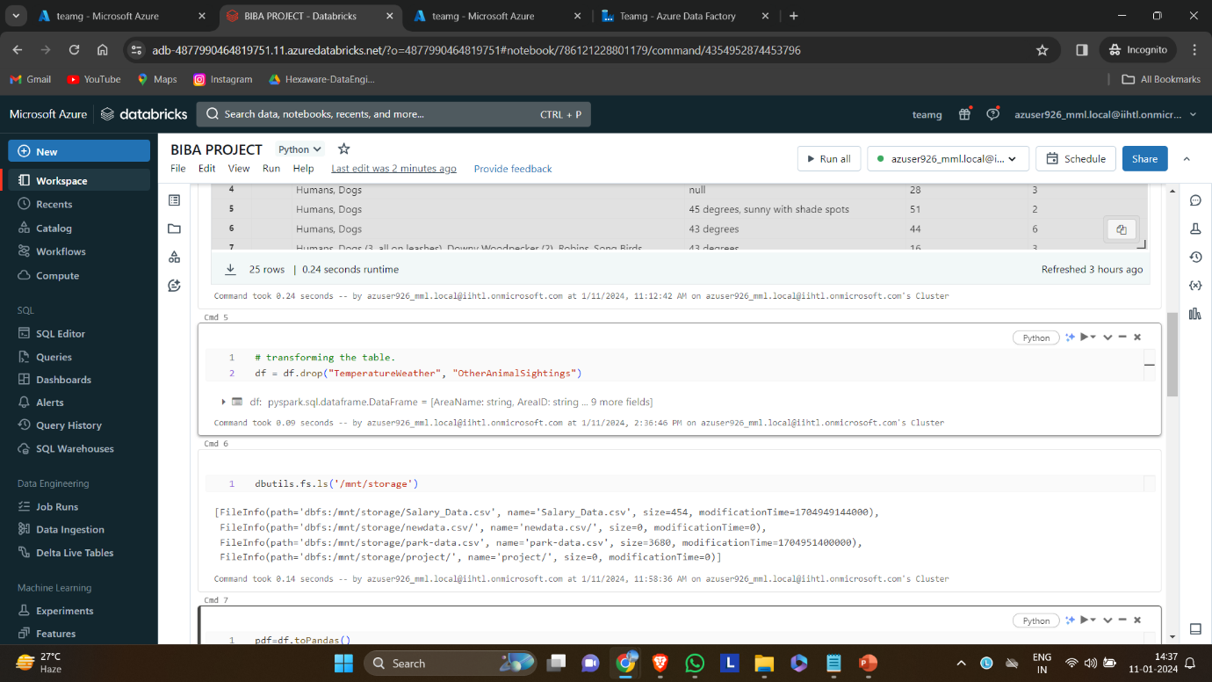
Transforming schema

Slide 19
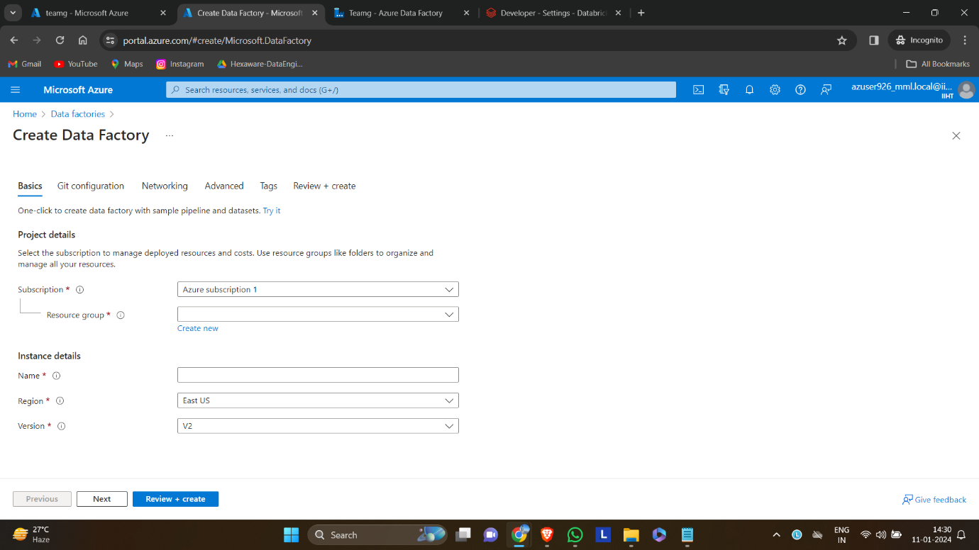
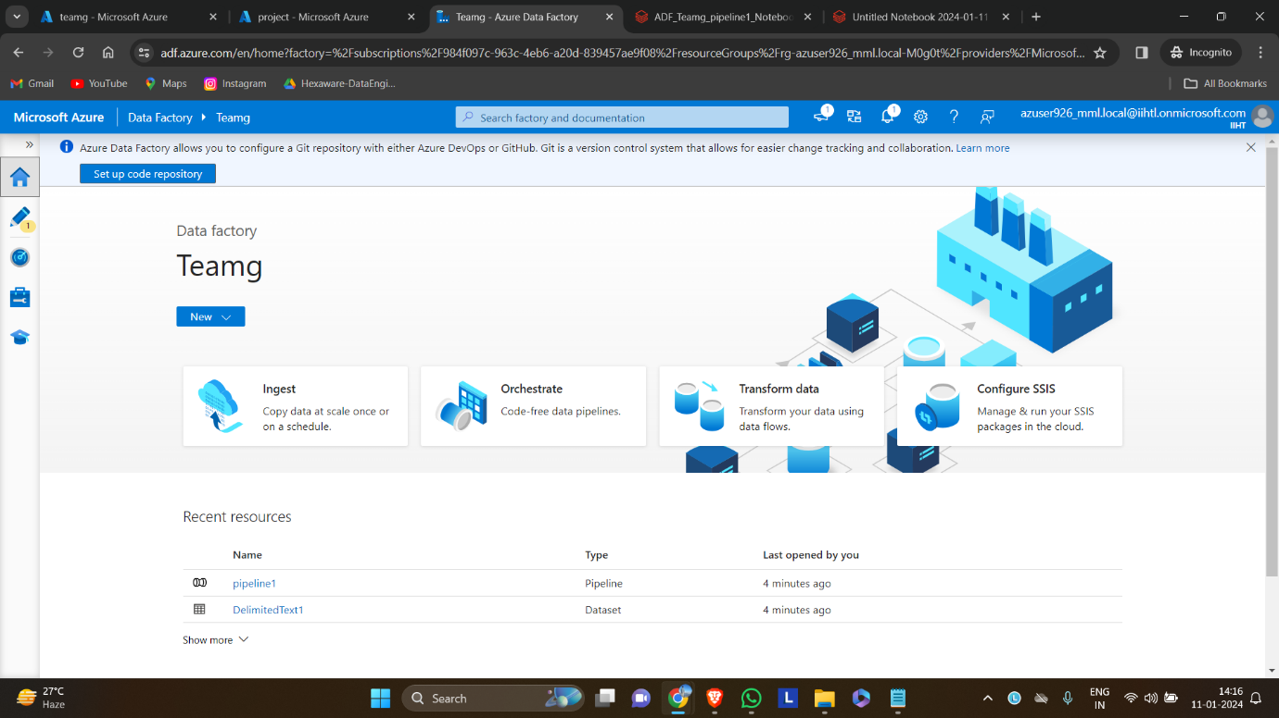
Creating azure data factory

Slide 20
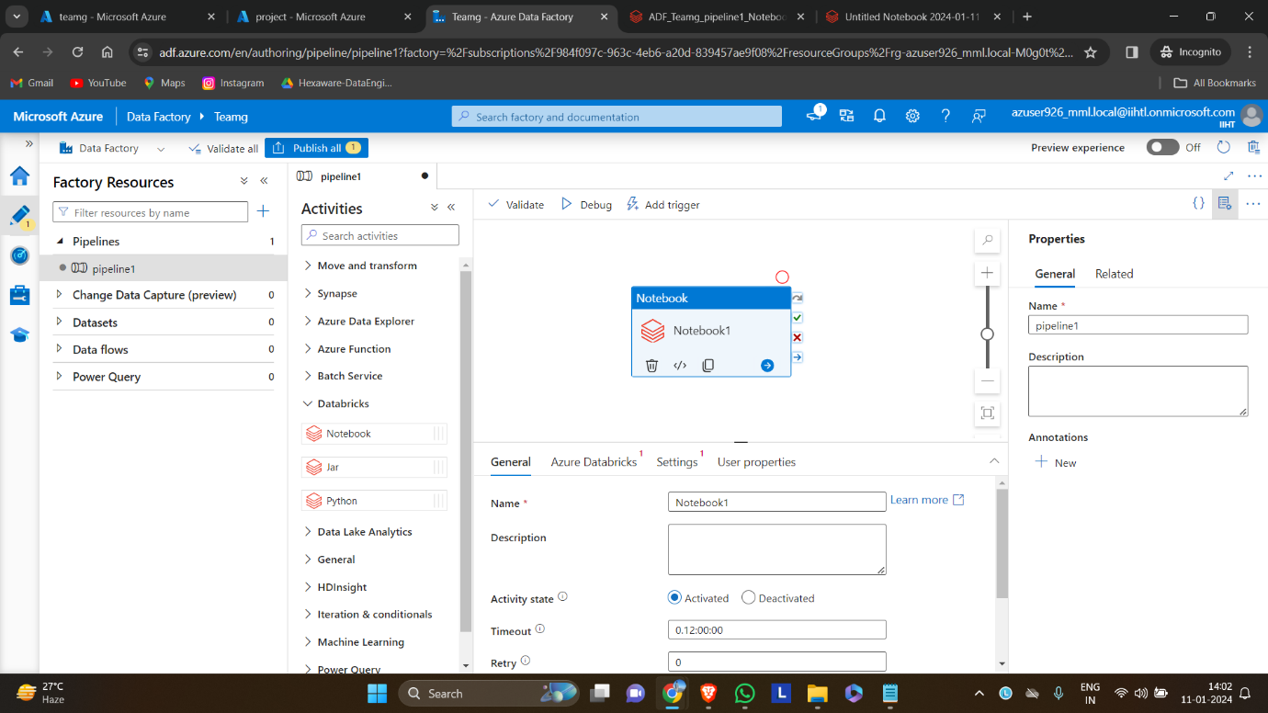
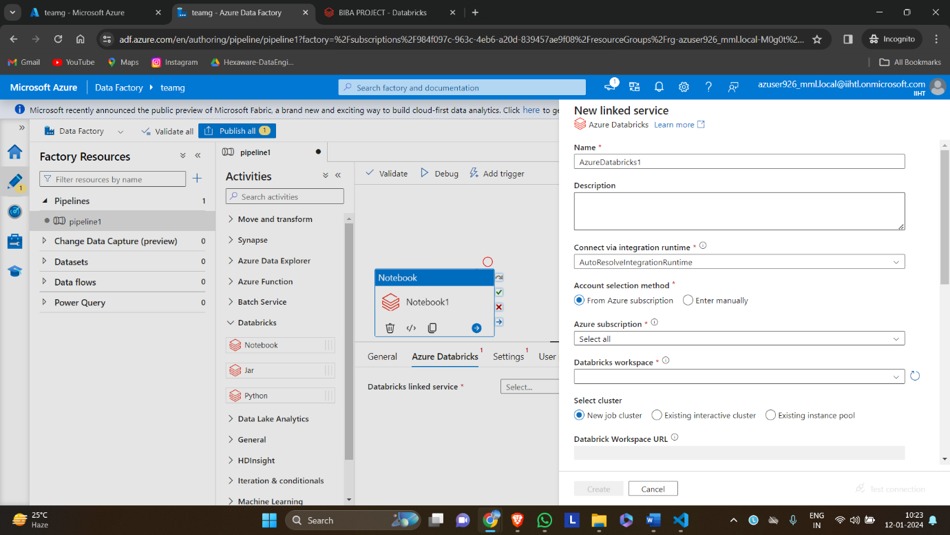
Creating a pipeline

Slide 21
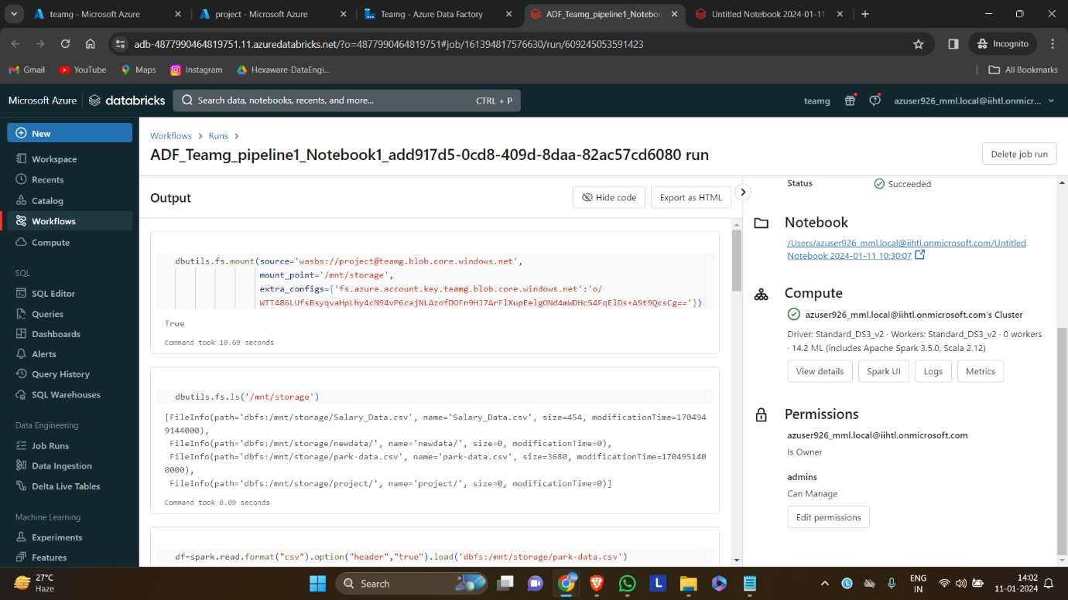
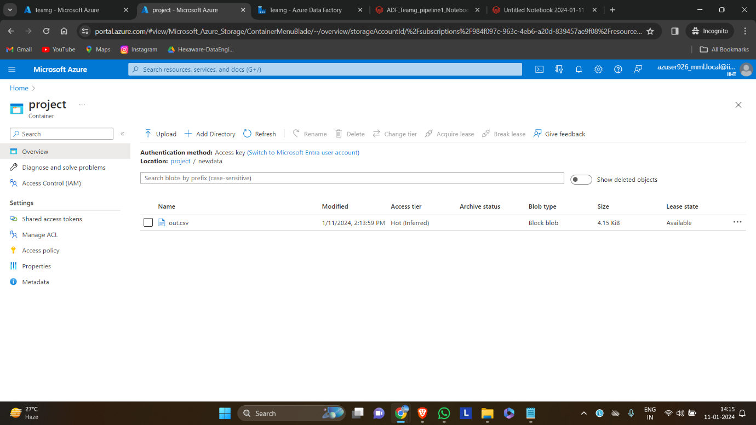
Review results

Slide 22
conclusion
By following these steps, the project establishes an adaptive data processing pipeline where Azure Data Factory handles schema evolution by moving data to the Data Lake, and Azure Databricks dynamically adjusts the schema based on the evolving nature of incoming data.

Slide 23
Q & a

Slide 24
Thank you

